Slide 1


Q-Learning Reinforcement learning
Florida Atlantic University - CAP 6229 Reinforcement Learning
Shaun Pritchard * Email: spritchard2021@fau.edu * Spring 2022
College of Engineering and Computer Science
Notes:
Welcome to my presentation for CAP 6229 Reinforcement Learning
For those of you who do not know this bright little characters name is Q-bert
Q*bert was an arcade game released around 1982
Like in reinforcement learning Q-bert is an agent whose job is to navigate the digital environment by taking actions and moving through different states by the human user controlling him in order to receive the reward of moving to the next level.

Slide 2
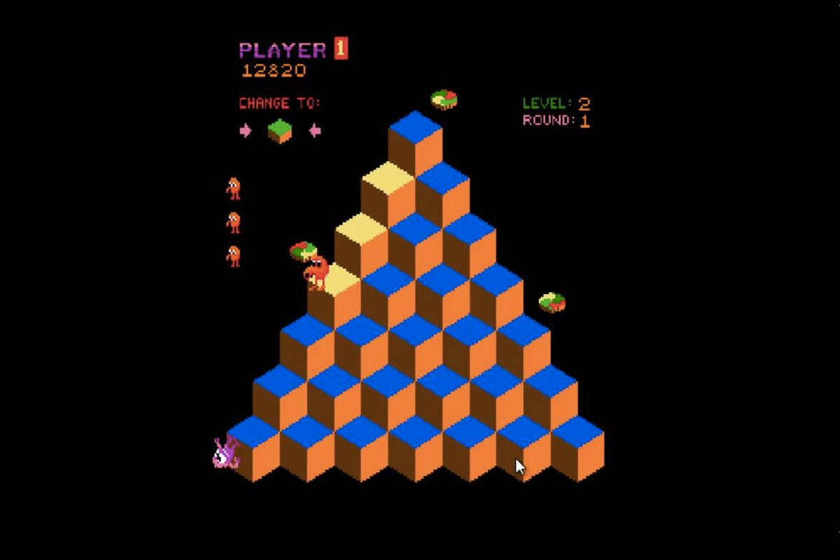
Q-Bert in Q-learning
Notes:
Unfortunately Q-bert ulike Q-learning was navigated through obstacles by human intelligence.

Slide 3
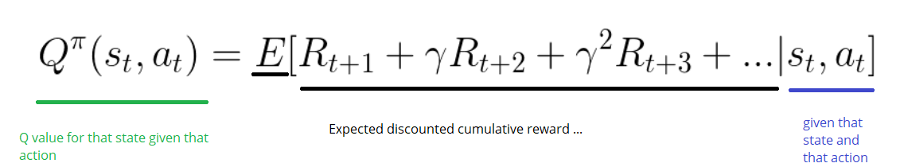
Q-learning
Notes:
By contrast, Q-learning is considered deterministic in that its output is determined solely by the input and initial conditions, thereby always returning the same results.
It also has better cabilbilites for handling real world scenarios for learning environments

Slide 4
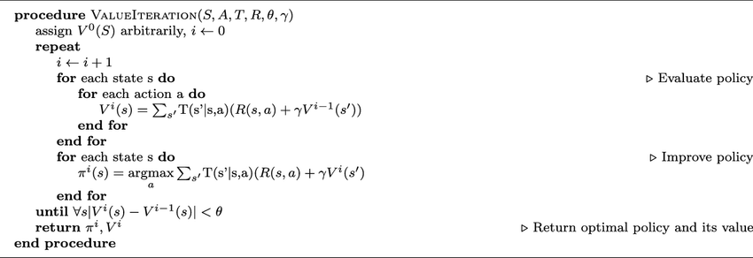
Value Iteration
Notes:
Value iteration
We see that It has problems such as:
Policy may converge sooner than values (policy iterations)
Policy extraction is a second step
And assumes perfect knowledge of transition and reward functions
This is not very practical for real world applications

Slide 5
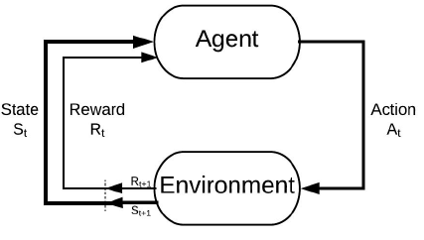
RL Models
Notes:
So in retrospect when we look at reinforcement learning and see that there are 2 main types of RL algorithms models:
Model-free algorithms estimate the optimal policy without estimating or using the dynamics (transition and reward functions) of the environment.
In contrast, a model-based algorithm estimates the optimal policy based on the transition function (and the reward function).
A RL agent is not "model-based" just because there is a model of the environment implemented. The learning algorithms must explicitly refer to the model in order to qualify as "model-based":

Slide 6
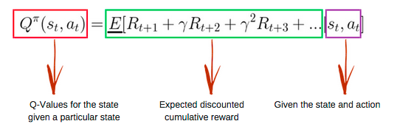
Q-Function
Notes:
The Q-learning algorithm learns the optimal Markov Decision Process (MDP) policy based on Q-values which estimate the “value” of taking an action at a given state.
The policy can then learn from these values by inferring them to a Q-table
Q-functions are based on the Bellman equation and take two inputs: state (s) and action (a).

Slide 7
Q-Learning Algorithm
Initialize Q-Table
Choose an Action
Iteration Results for the Q-Table
Perform Action
Calculate reward
Update Q-Table
Iterate until convergence
Notes:
Follow flow of Q-learning

Slide 8
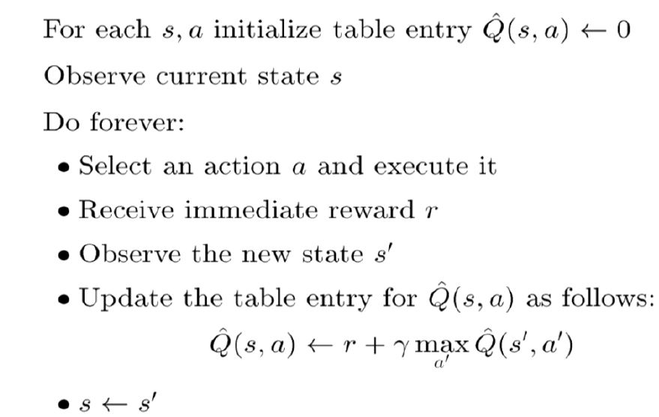
Q-Learning Definition
Notes:
Q-learning Definition
Follow the pseudocode and explain

Slide 9
Q-Learning Basics
Q(s, a) < -Q(s, a) + R+ γ * maxa Q(s', a')
State
Action
Previous
State
Action
Notes:
For every possible state and action, there is a Q-value in a standard Q-learning approach.
As a result of taking action A in state S, Q represents the utility of the action in that state; that is, roughly, the expected future reward R.
Q-value flow explains: =
Were s is the current state, a is the current action, s′ is the next state, and a′ represents an action from s′, and were γ represents the discount factor for q-values as agents move through the grid, they update their Q-values to the Q-table as they go. An episode is the sequence of actions taken from the starting state to the terminal state.

Slide 10
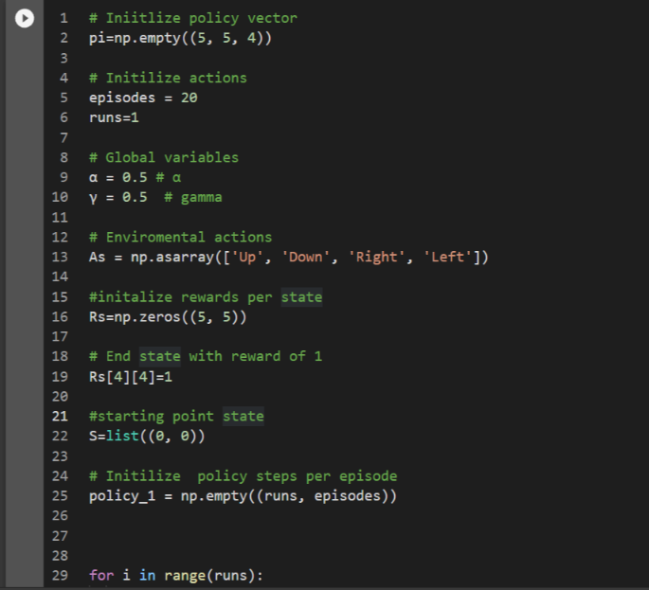
Q-Learning Initialization
Requirements:
5 x 5 grid world
End state of 4 with reward of 1
Alpha = 0.1
Gamma = 0.9
1000 iterations
Notes:
We will use a 5x5 grid world where the starting state is (0, 0) and the end state is (4, 4).
With a learning rate of .1 and and error rate gamma at 0.9 to reach maximum convergence
Here, α∈[0,1] is the step size, based on new evidence from the environment, we will determine how aggressively we should update our estimates parameters.
Q-value is assigned to every possible state or action
It can be thought of as the expected future rewards R of taking action A when in a particular state S; the Q-value thus representing that futuristic reward.
Agents in this grid world continue taking actions until they reach their terminal state, updating their Q-values
I tried altering both the learning rate and error rate and found this to be the best convergence

Slide 11
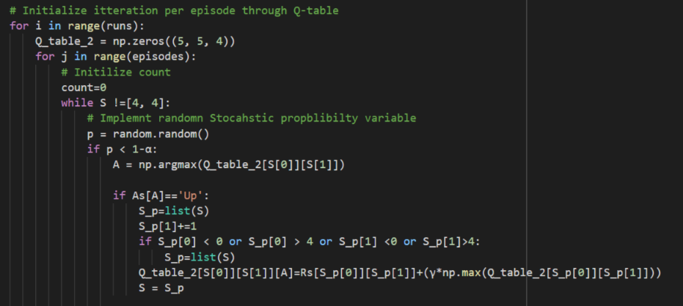
Q-Learning Code
Notes:
Program intilizes with 3 simple loops
The inner loop implements the policy for the stochastic probability updating action s and state
While the outer loop updates the final iteration of the Q table
And the middle loop initializes the count and random actions to implement each episode

Slide 12
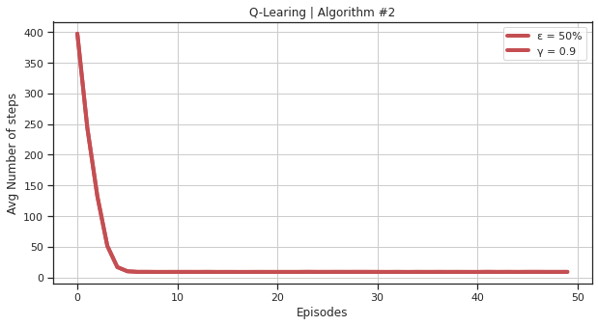
Q-Learning Results
Notes:
Results:
Based on the step-to-goal curve, we can see that with an epsilon of 0.1, the agent learns the optimal policy by the eighth episode and the step-to-goal curve converges. The agent tries to find a better policy in the first eight episodes.

Slide 13
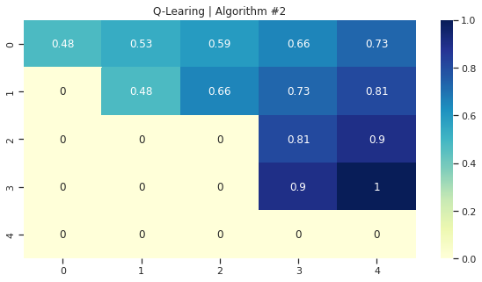
Q-Learning Results
Notes:
Results from heatmap:
By looking at the heatmap Vtable, it is clear that the optimal policy is to move East 4 times, and North 4 times, resulting in an average of 8 steps per episode.

Slide 14
Q-Learning Reinforcement learning
Florida Atlantic University - CAP 6229 Reinforcement Learning
Shaun Pritchard * Email: spritchard2021@fau.edu * Spring 2022
College of Engineering and Computer Science
Notes:
End

Slide 15
Q-Learning Reinforcement learning
Florida Atlantic University - CAP 6229 Reinforcement Learning
Shaun Pritchard * Email: spritchard2021@fau.edu * Spring 2022
College of Engineering and Computer Science

